Slide 1
Building an Automated,
Polyglot Data Pipeline
Group 2: Data Orchestrators
Guna Prakash Kethineni · Kaustubh · Niranjan · Manav
ETL · Polyglot Persistence · Orchestration · Prefect · MySQL · MongoDB · Streamlit

Slide 2
The Business Problem
Why traditional BI tools fall short
80%
10K+
0
of the world's data is unstructured
words in a single city council transcript
SQL queries possible on raw text blobs
Our Mission
Build a system that automatically extracts text from city council records, engineers measurable metrics from it, and stores it in a highly queryable format — enabling BI analysis on previously unstructured governance data.

Slide 3
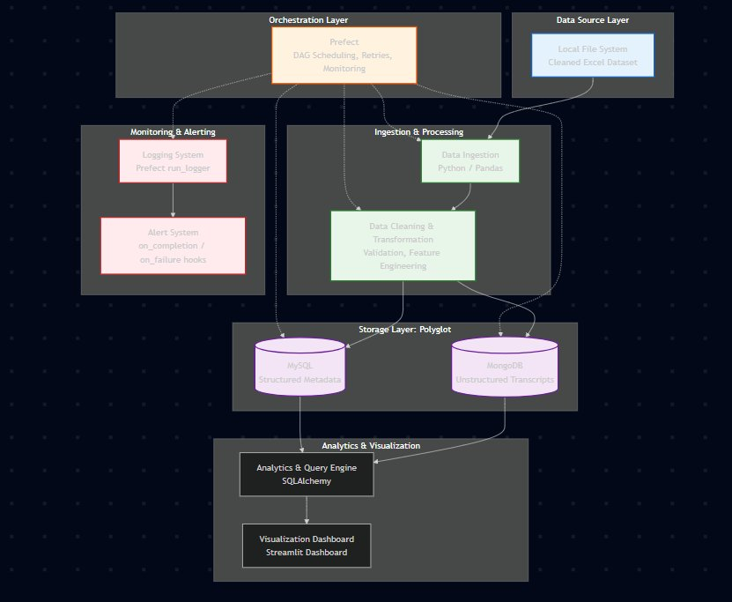
System Architecture
5-layer pipeline from raw data to analytics dashboard
Orchestration
Prefect — DAG scheduling, retries, monitoring
Ingestion & Processing
Python / Pandas — extraction, cleaning, feature engineering
Storage: Polyglot
MySQL (metadata) + MongoDB (transcripts)
Monitoring & Alerting
Prefect run_logger + on_completion / on_failure hooks
Analytics & Visualization
SQLAlchemy + Streamlit dashboard

Slide 4
The ETL Paradigm
Extract, Transform, Load — the industry standard for data warehousing
E
T
L
Extract
▶
Transform
▶
Load
Pull raw data from source
(Excel file, API, DB)
Clean, validate & engineer
new analytical features
Write structured data
to target databases
Why ETL over ELT?
Loading raw, 10,000-word uncleaned strings directly into a relational database is highly inefficient. By transforming in-memory first, we ensure clean, structured data reaches MySQL and only the heavy unstructured text goes to MongoDB.

Slide 5
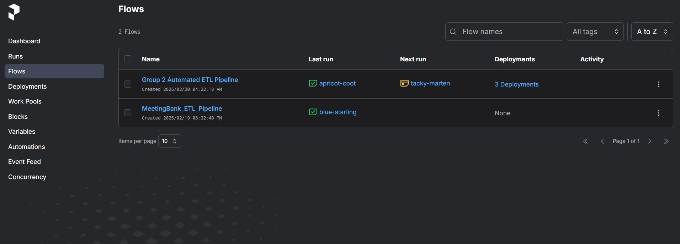
Extraction & Validation
Phase 1 — Ingesting and integrity-checking the source data
PYTHON
📥 Pandas read_excel
@task(name="Ingest & Clean Data")
def extract_data():
df = pd.read_excel(EXCEL_PATH)
df.columns = df.columns.
str.strip().str.lower()
df = df.dropna(subset=['uid'])
return df
Vectorized file reading — faster than row-by-row
🔤 Header standardization
Strip whitespace & lowercase all column names
🛡️ dropna(subset=['uid'])
Drop corrupted rows missing a Unique ID — protects DB integrity

Slide 6
Feature Engineering
Deriving analytical variables from raw unstructured text
"A block of text tells you nothing. Numbers tell you everything."
📄
🔢
📏
Raw Input
➜
word_count
➜
char_length
10,000 words of meeting minutes
Exact numeric word count per transcript
Total character length for data quality checks

Slide 7
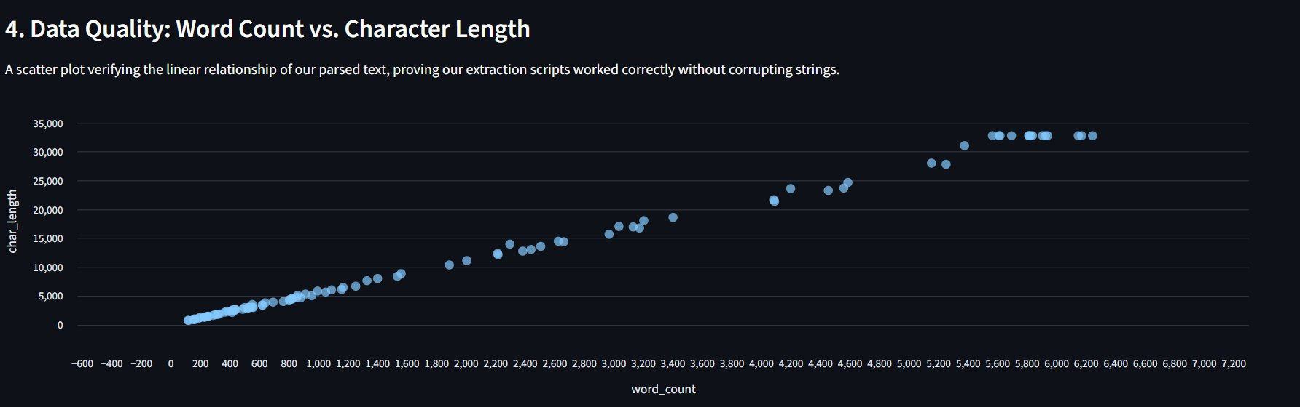
Calculating Text Metrics
Phase 2 — Lambda functions that run during the Transformation phase
PYTHON
Lambda Functions
df["word_count"] = df["transcript"].
astype(
str).apply(
lambda x: len(x.split()))
df["char_length"] = df["transcript"].
astype(
str).apply(len)
Anonymous functions applied to every row in-memory during Transform phase — before any DB write
len(x.split())
Splits string on whitespace and counts resulting tokens — exact word count
📊 Result: Word Count vs. Character Length
apply(len)
Calculates total character count directly from the string
Zero DB overhead
Both metrics computed in-memory before data ever touches MySQL or MongoDB

Slide 8
Polyglot Persistence
Using the right database model for each type of data
MySQL — Relational (SQL)
MongoDB — Document (NoSQL)
⚡ Lightning-fast aggregations & JOINs
📄 Native support for large text documents
🔢 Perfect for numeric metadata
🔓 Schema-flexible — no rigid columns
VS
📊 Ideal for BI dashboards & KPIs
📦 Stores full transcript as one document
✅ ACID compliant — data integrity
🔍 Full-text search capable
❌ Terrible for 10,000-word text blobs
❌ Slower for numeric aggregations
❌ VARCHAR limits & performance issues
❌ Not optimized for JOIN operations
Solution: Split the data stream — route structured metadata to MySQL, heavy transcripts to MongoDB.

Slide 9
Splitting the Workload
Phase 3 — Routing data to the right database
🗄️ MySQL — Structured Metadata
🍃 MongoDB — Transcripts
Column | Type | Purpose
uid | VARCHAR | Primary Key — links to MongoDB
summary | TEXT | Short meeting summary
word_count | INT | Engineered feature
char_length | INT | Engineered feature
loaded_at | DATETIME | ETL timestamp
Field | Type | Purpose
uid | String | Links to MySQL metadata
transcript | String | Full 10,000-word text
city | String | Municipality name
loaded_at | Date | ETL timestamp
⇄
uid
Both tables share the same uid primary key, enabling JOIN queries between MySQL analytics and MongoDB transcripts.

Slide 10
Data Pipeline Idempotency
A core data engineering concept for production-grade pipelines
Idempotency:
An operation that can run 100 times will produce the same result as running it once. Pipelines must never duplicate data if they accidentally execute twice.
🐛 The Bug We Found During Testing
✅ The Idempotent Fix
Pipeline ran twice → duplicate rows inserted
Database hit 300 records instead of 100
All aggregations and KPIs were wrong
Root cause: no truncation before insert
TRUNCATE TABLE before every MySQL insert
collection.delete_many({}) for MongoDB
Result: always exactly 100 records
Pipeline safe to re-run at any time
→
Outcome: Database stabilized at exactly 100 records. Metrics are always accurate, regardless of how many times the pipeline runs.

Slide 11
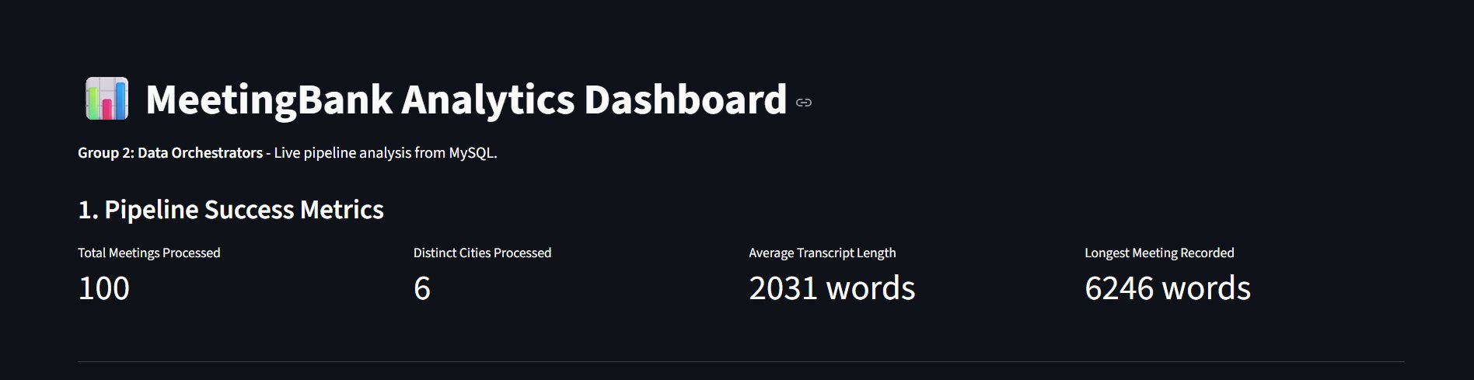
Idempotent Loaders
Phase 3b — TRUNCATE-before-insert pattern for both databases
PYTHON
TRUNCATE TABLE
# MYSQL — Idempotent Loader
cursor.execute("TRUNCATE TABLE meetings_metadata;")
insert_query = "INSERT INTO meetings_metadata (uid, summary, word_count, char_length, loaded_at) VALUES (%s, %s, %s, %s, %s)"
for _, row in df.iterrows():
cursor.execute(insert_query, (...))
# MONGODB — Idempotent Loader
collection.delete_many({}) # Wipe all
Wipes the MySQL table instantly — faster than DELETE, resets auto-increment counter
delete_many({})
Removes all documents from MongoDB collection — empty filter {} matches everything
Fresh insert loop
After wipe, re-inserts all 100 rows fresh — guarantees consistent state
100 Records Confirmed
Dashboard KPI verifies exactly 100 meetings processed — not 200, not 300

Slide 12
Orchestration
Automation is the core requirement for production data pipelines
Running manual Python scripts is not scalable. Orchestration tools manage scheduling, dependency mapping, failure recovery, and monitoring of complex multi-step tasks automatically.
🐍 Native Python
🔀 DAG Visualization
🔁 Retry Logic
@task and @flow decorators — no YAML config, no separate DSL
Automatic task dependency graph with real-time status monitoring
Built-in retries with configurable delay — self-healing pipelines
⏰ Scheduling
🪝 Event Hooks
☁️ Prefect Cloud UI
CRON and interval-based deployments with zero code changes
on_completion and on_failure callbacks for admin alerts
Real-time dashboard for monitoring all runs and deployments

Slide 13
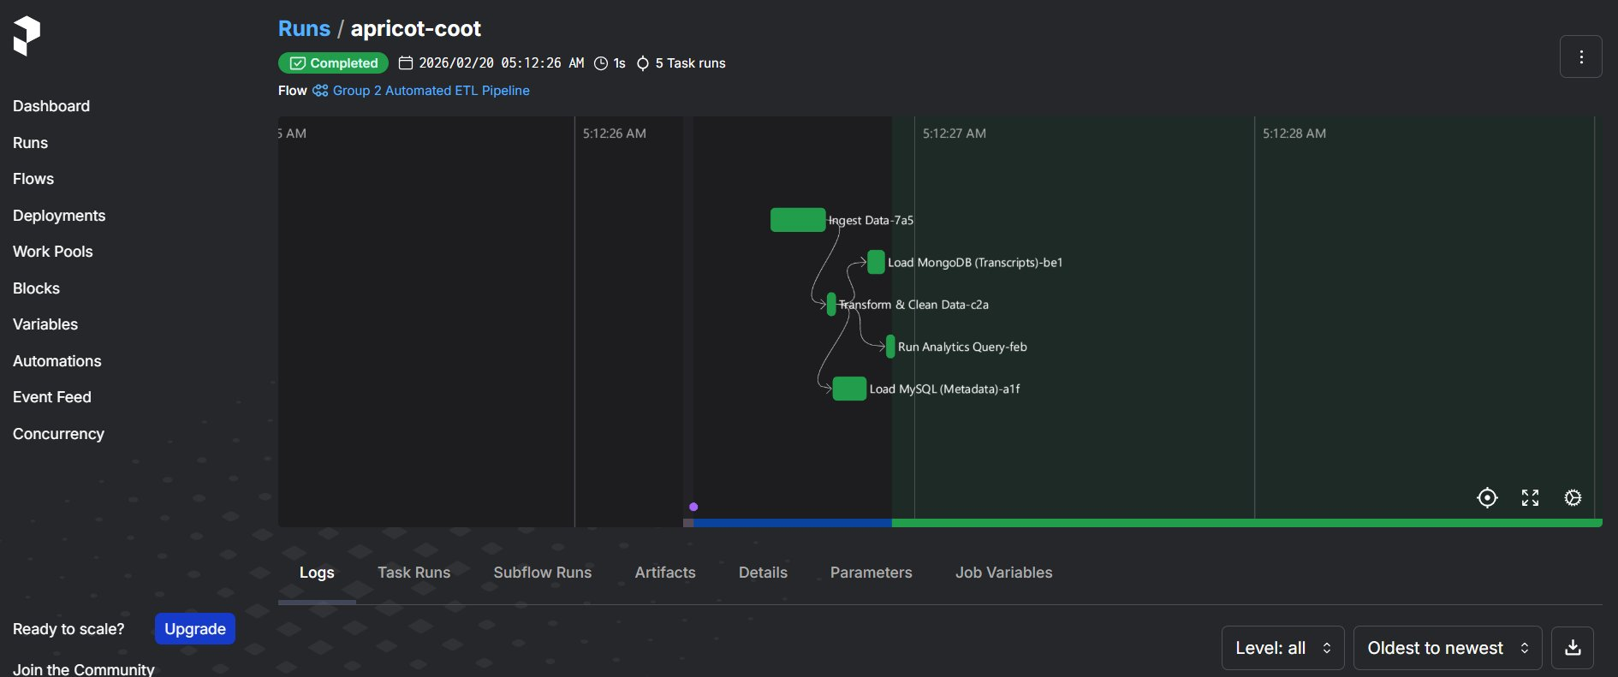
The Directed Acyclic Graph (DAG)
Phase 4 — Dependency mapping with Prefect @task blocks
PYTHON
@flow(name="Group 2 ETL Pipeline")
def meeting_pipeline_flow():
raw = extract_data()
clean = transform_data(raw)
# Concurrent loading
mysql_s = load_mysql(clean)
mongo_s = load_mongodb(clean)
analytics_summary(
clean,
wait_for=[mysql_s, mongo_s])
The DAG proves: MySQL and MongoDB load in parallel, but the Analytics task is gated — it cannot start until both databases report 100% success.

Slide 14
Fault Tolerance
Production pipelines must be self-healing, not brittle
In production, databases time out and network requests drop. A brittle pipeline crashes and requires manual intervention. A resilient pipeline catches errors and tries again automatically.
💀 Brittle Pipeline
✅ Resilient Pipeline (Ours)
MySQL connection drops → pipeline crashes
Data is partially loaded (corrupt state)
Engineer gets paged at 3 AM
Manual re-run required
No record of what failed or why
Connection drops → Prefect pauses 5 seconds
Automatic retry (up to 2 attempts)
Admin alert fires via on_failure hook
Idempotent loader ensures clean state on retry
Full run log available in Prefect Cloud
→

Slide 15
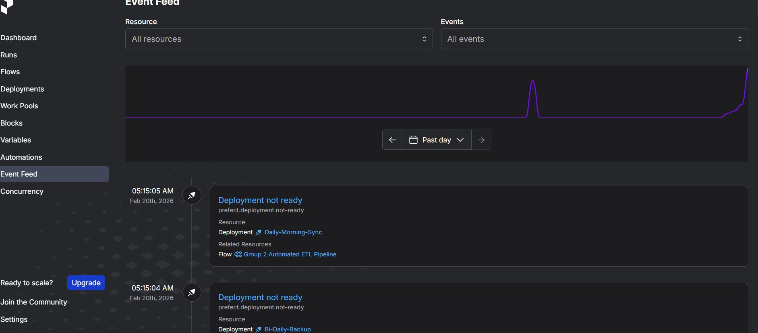
Automated Retries & Event Hooks
Phase 5a — Self-healing pipeline with admin notifications
PYTHON
🔁 retries=2
@task(retries=2, retry_delay_seconds=5)
def load_mysql(df): ...
def on_pipeline_success(flow, params, result):
notify_admin("✅ ETL Completed")
def on_pipeline_failure(flow, params, result):
notify_admin("🚨 ETL Failed")
@flow(on_completion=[...], on_failure=[...])
def meeting_pipeline_flow(): ...
If MySQL task fails, Prefect automatically retries up to 2 more times
⏱️ retry_delay_seconds=5
5-second pause between retries — gives the DB time to recover
✅ on_completion hook
Fires when entire pipeline succeeds — sends admin success notification
🚨 on_failure hook
Fires if pipeline fails after all retries — immediate admin alert

Slide 16
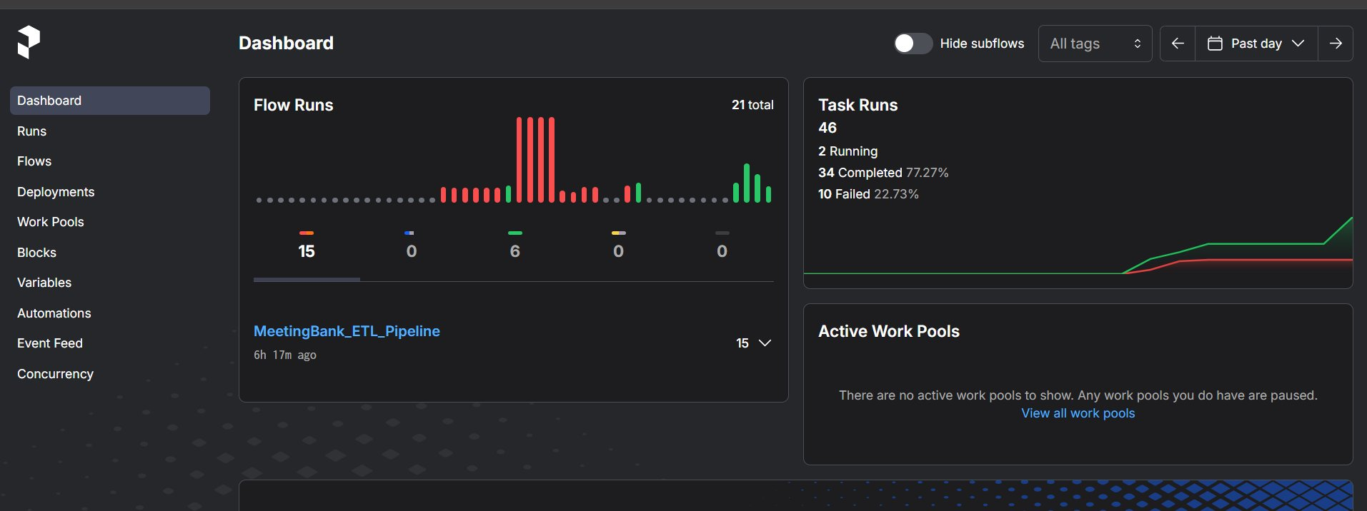
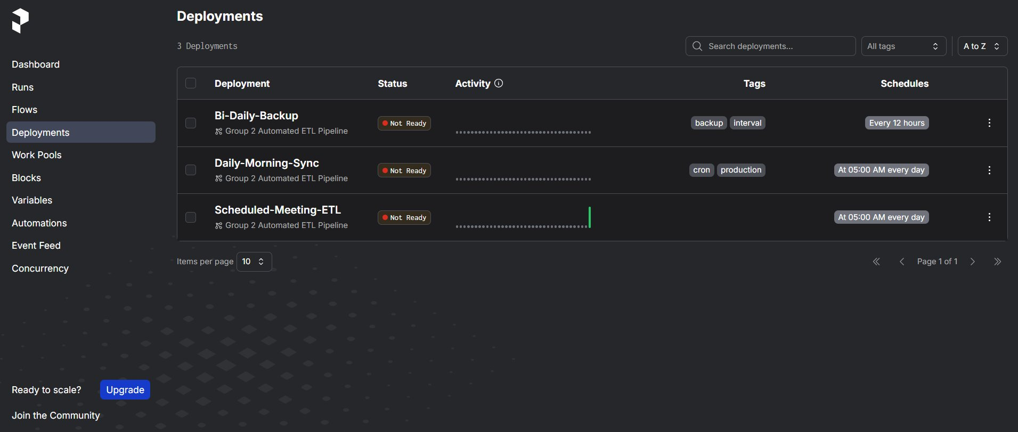
Automated Scheduling Deployments
Phase 5b — Zero human intervention with CRON and interval schedules
PYTHON
# CRON-based daily sync
daily = meeting_pipeline_flow.to_deployment(
name="Daily-Morning-Sync",
cron="0 5 * * *" # 5:00 AM )
# Interval-based backup
backup = meeting_pipeline_flow.to_deployment(
name="Bi-Daily-Backup", interval=43200
)
Prefect Cloud — Live Dashboard

Slide 17
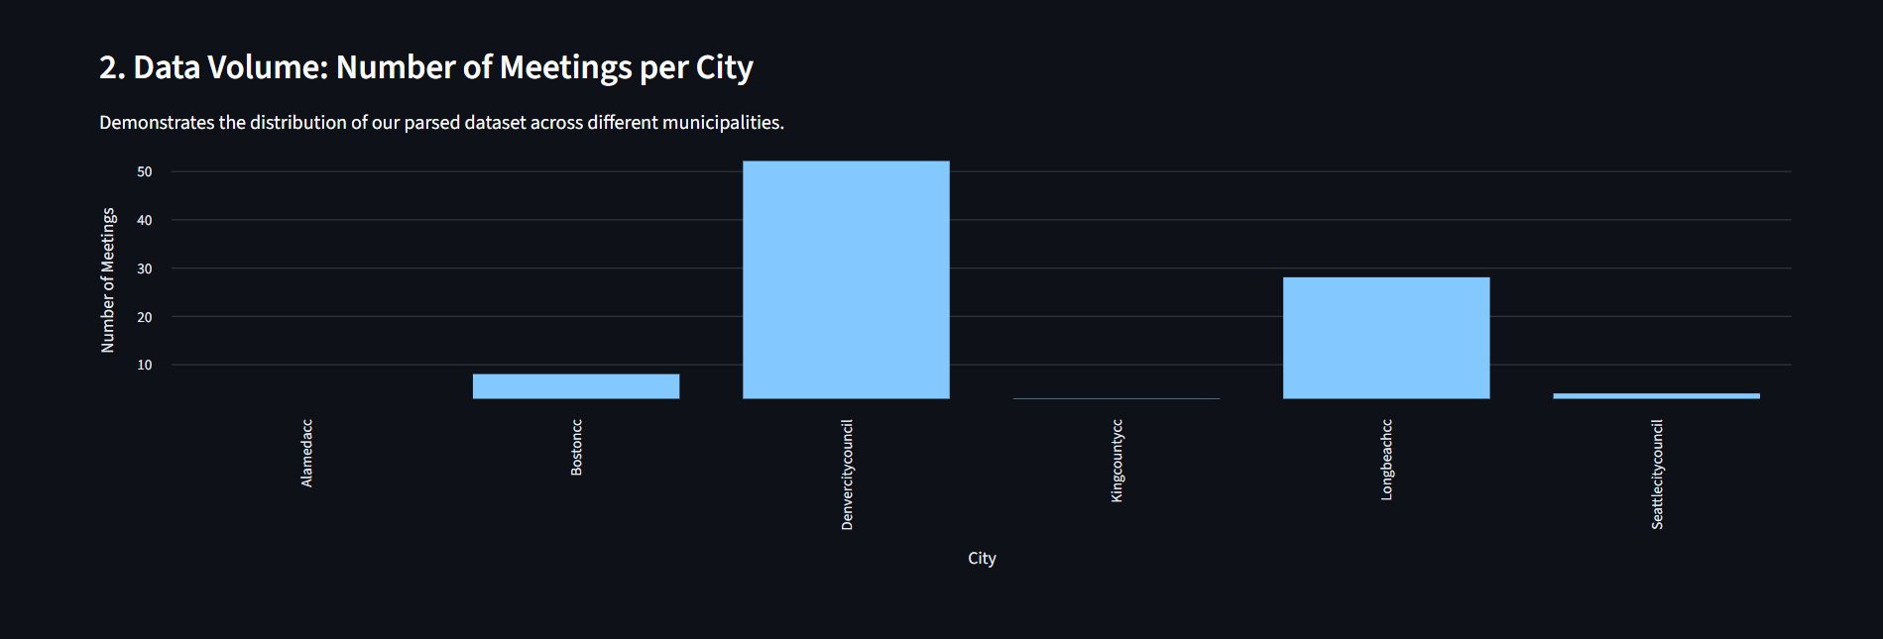
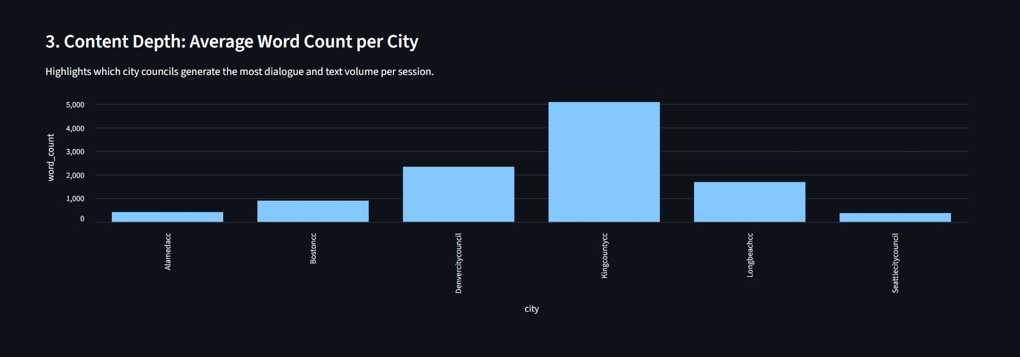
Streamlit Analytics Dashboard
Making ETL results accessible to non-technical business users
📊 Data Volume: Meetings per City
📊 Content Depth: Avg Word Count per City
Business Insight: Denver had the highest volume (50 meetings), but King County had the deepest content (~5,100 avg words/meeting). This means King County produced fewer but more substantive council sessions.

Slide 18
Data Quality Verification
Linear correlation proves extraction scripts worked without corrupting strings
Perfect linear correlation between word_count and char_length confirms our Lambda extraction functions ran correctly — no strings were truncated, duplicated, or corrupted.

Slide 19
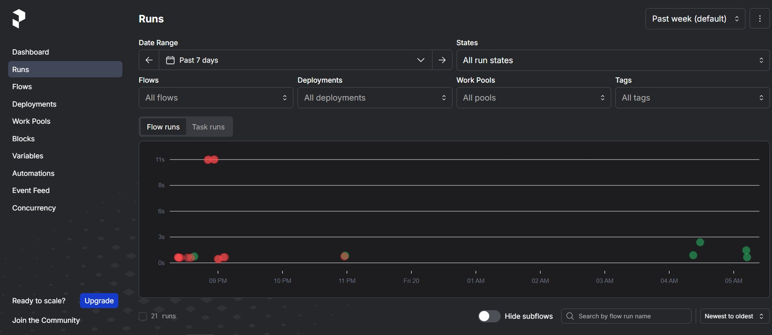
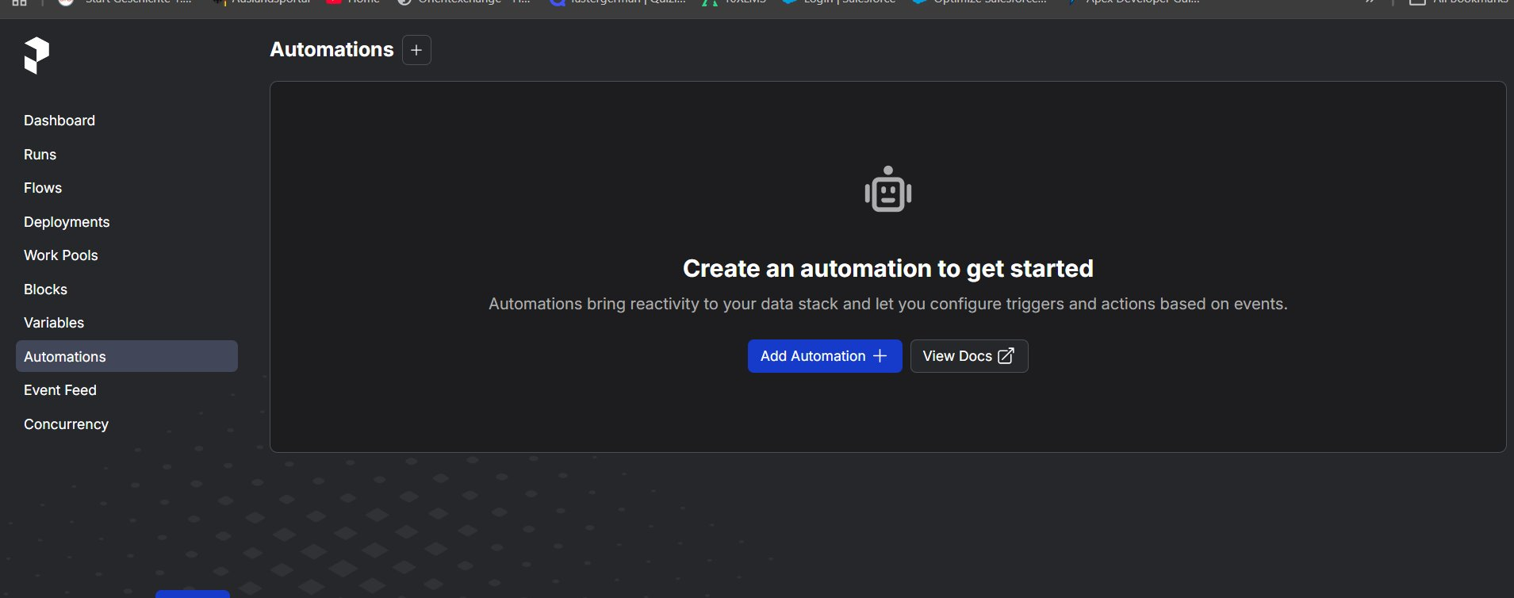
Prefect Monitoring Dashboard
Real-time visibility into all pipeline runs and task performance
21
46
Total Flow Runs
Total Task Runs
77%
2
Task Success Rate
Active Work Pools
Pipeline ran 21 times during development and testing — Prefect logged every run, task, and retry event.

Slide 20
Conclusion & Deliverables
Group 2: Data Orchestrators
✅ Polyglot Storage
✅ Automated DAG
MySQL for structured metadata + MongoDB for transcripts — best of both worlds
Prefect dependency graph with concurrent MySQL/MongoDB loading + sequential analytics
✅ Idempotent Pipeline
✅ Scheduled Deployments
TRUNCATE-before-insert pattern — safe to re-run, always exactly 100 records
Daily-Morning-Sync (CRON 5AM) + Bi-Daily-Backup (12hr interval) — zero manual runs
✅ Fault Tolerance
✅ Analytics Dashboard
retries=2, retry_delay=5s, on_failure hooks — self-healing production architecture
Live Streamlit + SQLAlchemy BI layer — data accessible to non-technical stakeholders
Thank you for your time — we are open for questions.

